Slide 1
A presentation on
Counters
Information obtained using educative resources from the WWW.
http://www.eelab.usyd.edu.au/digital_tutorial/part2/counter02.html
http://en.wikipedia.org/wiki/Counter

Slide 2
Introduction
Circuits for counting events are frequently used in computers and other digital systems.
Since a counter circuit must remember its past states, it has to possess memory.
The number of flip-flops used and how they are connected determine the number of states and the sequence of the states that the counter goes through in each complete cycle.

Slide 3
Two principal categories
Counters are divided in two categories, these are:
  Asynchronous (Ripple) Counters - the first flip-flop is clocked by the external clock pulse, and then each successive flip-flop is clocked by the Q or Q' output of the previous flip-flop.
  Synchronous Counters - all memory elements are simultaneously triggered by the same clock.

Slide 4
Many categories
Asynchronous (ripple) counter
Synchronous counter
Ring counter
Johnson counter
Decade counter
Up–down counter

Slide 5
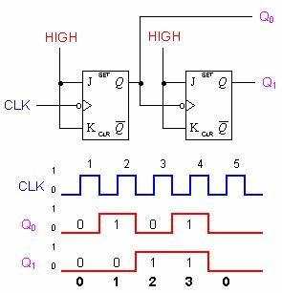
Two-bit asynchronous counter
A two-bit asynchronous counter is shown on the left.
It uses two J-K flip flops.

Slide 6
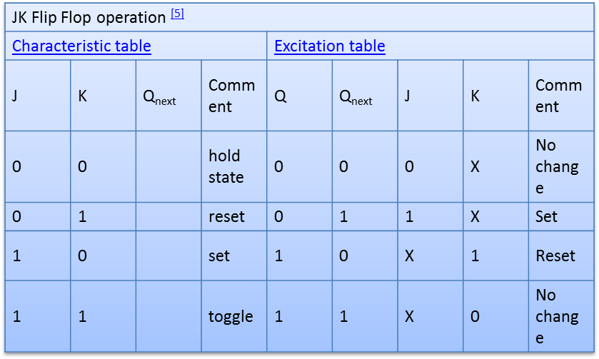
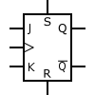
Remember: J-K Flip Flop

Slide 7
J-K Flip Flop is universal
(good summary)
The JK flip-flop augments the behavior of the SR flip-flop (J=Set, K=Reset) by interpreting the S = R = 1 condition as a "flip" or toggle command.
Specifically, the combination J = 1, K = 0 is a command to set the flip-flop; the combination J = 0, K = 1 is a command to reset the flip-flop; and the combination J = K = 1 is a command to toggle the flip-flop, i.e., change its output to the logical complement of its current value.
Setting J = K = 0 does NOT result in a D flip-flop, but rather, will hold the current state.
To synthesize a D flip-flop, simply set K equal to the complement of J.
The JK flip-flop is therefore a universal flip-flop, because it can be configured to work as an SR flip-flop, a D flip-flop, or a T flip-flop.
NOTE: The flip flop is positive edge triggered (Clock Pulse) as seen in the timing diagram.

Slide 8
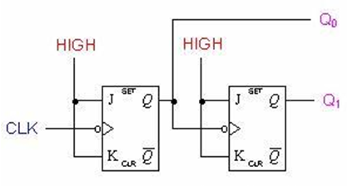
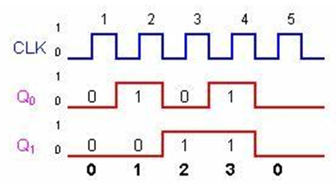
Two-bit asynchronous counter
The external clock is connected to the clock input of the first flip-flop (FF0) only.
So, FF0 changes state at the falling edge of each clock pulse, but FF1 changes only when triggered by the falling edge of the Q output of FF0.

Slide 9
Two-bit asynchronous counter
Because of the inherent propagation delay through a flip-flop, the transition of the input clock pulse and a transition of the Q output of FF0 can never occur at exactly the same time.
Therefore, the flip-flops cannot be triggered simultaneously, producing an asynchronous operation.

Slide 10
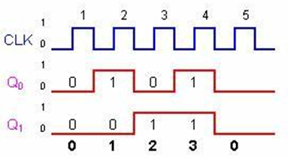
Two-bit asynchronous counter
Note that for simplicity, the transitions of Q0, Q1 and CLK in the timing diagram above are shown as simultaneous even though this is an asynchronous counter.
Actually, there is some small delay between the CLK, Q0 and Q1 transitions.

Slide 11
Two-bit asynchronous counter
Usually, all the CLEAR inputs are connected together, so that a single pulse can clear all the flip-flops before counting starts.
The clock pulse fed into FF0 is rippled through the other counters after propagation delays, like a ripple on water, hence the name Ripple Counter.

Slide 12
Two-bit asynchronous counter
The 2-bit ripple counter circuit above has four different states, each one corresponding to a count value.
Similarly, a counter with n flip-flops can have 2^{N} states.
The number of states in a counter is known as its mod (modulo) number.
Thus a 2-bit counter is a mod-4 counter.
A mod-n counter may also described as a divide-by-n counter.

Slide 13
Two-bit asynchronous counter
This is because the most significant flip-flop (the furthest flip-flop from the original clock pulse) produces one pulse for every n pulses at the clock input of the least significant flip-flop (the one triggers by the clock pulse).
Thus, the above counter is an example of a divide-by-4 counter.

Slide 14
Three-bit asynchronous counter
The following is a three-bit asynchronous binary counter and its timing diagram for one cycle.
It works exactly the same way as a two-bit asynchronous binary counter mentioned above, except it has eight states due to the third flip-flop.

Slide 15
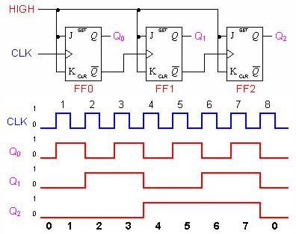
Three-bit asynchronous counter

Slide 16
Asynchronous counter
The binary counters previously introduced have two to the power n states.
But counters with states less than this number are also possible.
They are designed to have the number of states in their sequences, which are called truncated sequences.
These sequences are achieved by forcing the counter to recycle before going through all of its normal states.

Slide 17
Asynchronous counter
A common modulus for counters with truncated sequences is ten.
A counter with ten states in its sequence is called a decade counter.
The circuit below is an implementation of a decade counter.

Slide 18
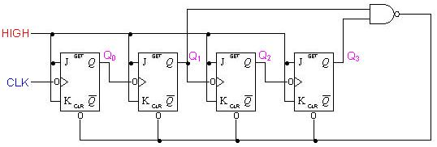
A Decade Counter is an asynchronous counter

Slide 19
Decade Counter
Once the counter counts to ten (1010), all the flip-flops are being cleared.
Notice that only Q1 and Q3 are used to decode the count of ten.
This is called partial decoding, as none of the other states (zero to nine) have both Q1 and Q3 HIGH at the same time.

Slide 20
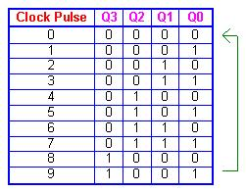
Decade Counter
The sequence of the decade counter is shown in the table below:

Slide 21
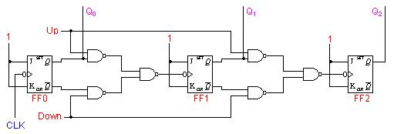
A Up-Down Counter is an asynchronous counter
In certain applications a counter must be able to count both up and down.
The circuit below is a 3-bit up-down counter.

Slide 22
Up-Down Counters
It counts up or down depending on the status of the control signals UP and DOWN.
When the UP input is at 1 and the DOWN input is at 0, the NAND network between FF0 and FF1 will gate the non-inverted output (Q) of FF0 into the clock input of FF1.
Similarly, Q of FF1 will be gated through the other NAND network into the clock input of FF2.
Thus the counter will count up.

Slide 23
Up-Down Counters
When the control input UP is at 0 and DOWN is at 1, the inverted outputs of FF0 and FF1 are gated into the clock inputs of FF1 and FF2 respectively.
If the flip-flops are initially reset to 0's, then the counter will go through the following sequence as input pulses are applied.

Slide 24
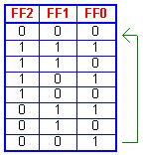
Up-Down Counters
Notice that an asynchronous up-down counter is slower than an up counter or a down counter because of the additional propagation delay introduced by the NAND networks.

